Slide 1
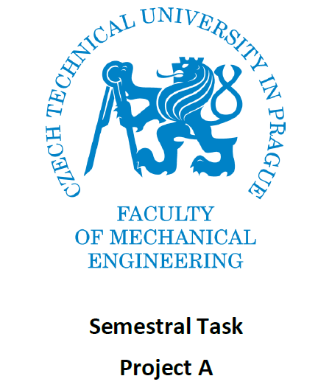

Slide 2
Project Description
Functionality Desired
There is a need to sand (cleanse) two arms of a U-shaped casting. The casting is put manually into the clamping facility. Then, via a START button, the command to begin the operation is relayed to the PLC. The casting is then clamped by the pneumatic motor A. Then, the pneumatic B opens the valve of the sanding nozzle and let it sand for the interval Ta. This interval of sanding is a parameter and it is possible to change it for each particular piece of casting from HMI facility (textual operator panel or PC with visualisation application). After completion of sanding of one arm of the casting, the pneumatic motor C moves the bed with the nozzle to second arm of the casting. The operation of sanding then repeats with the same interval. After competition of the second arm, the pneumatic motor C returns the bed of the sanding nozzle to the initial position. Then, the casting is released by the pneumatic motor A and it can be removed manually from the clamping bed.

Slide 3
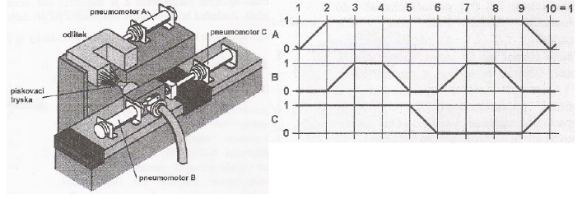
Situation and step diagram

Slide 4
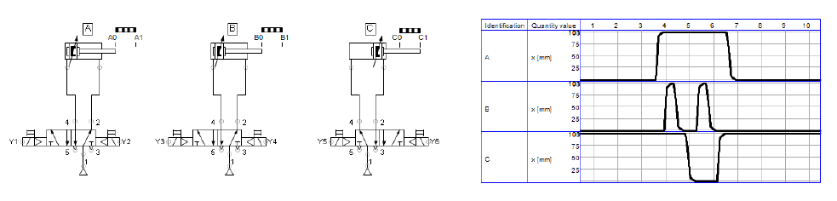
Model created in FluidSIM

Slide 5
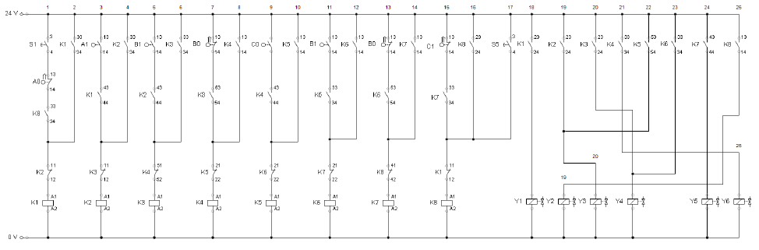
Circuit created in FluidSIM

Slide 6
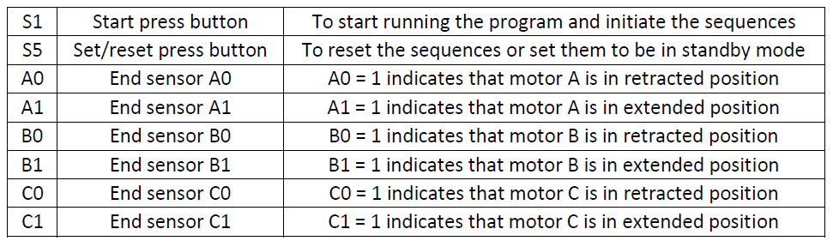
List of INPUTS

Slide 7
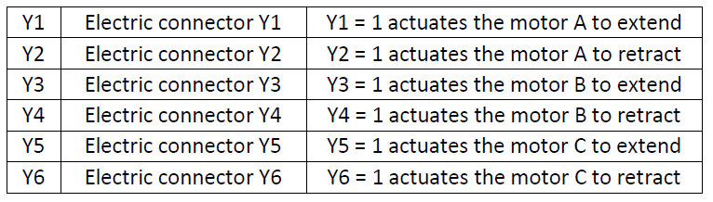
List of OUTPUTS

Slide 8
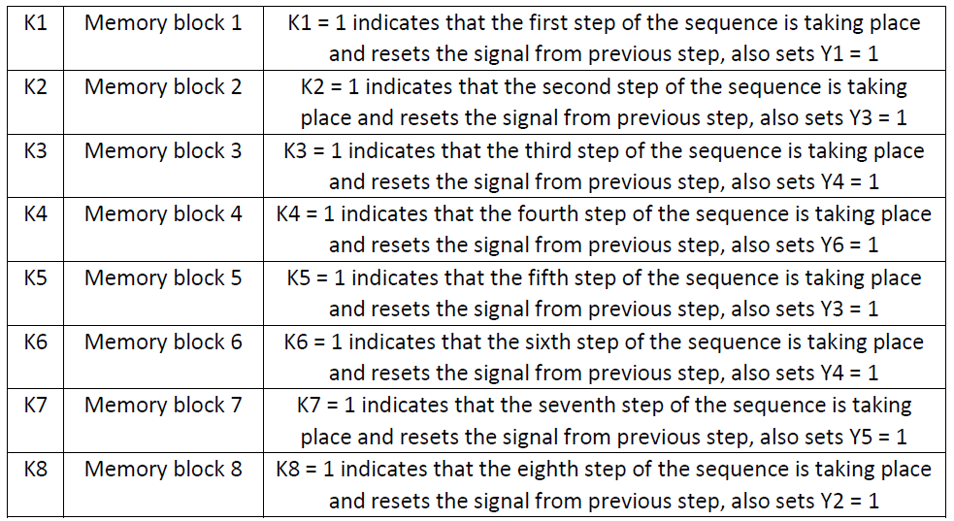
List of internal variables

Slide 9
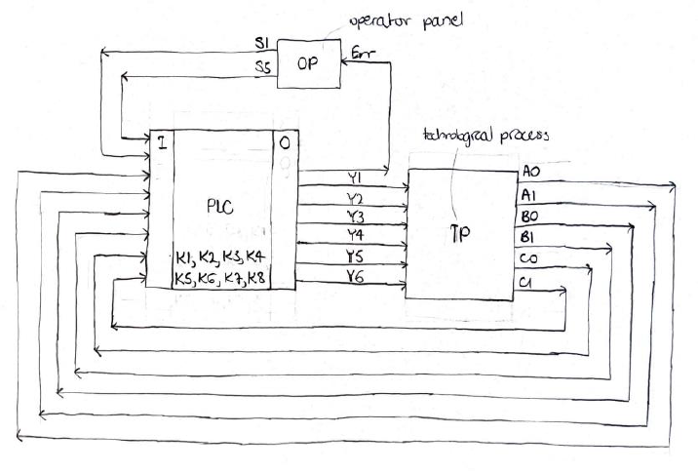
Block Diagram

Slide 10
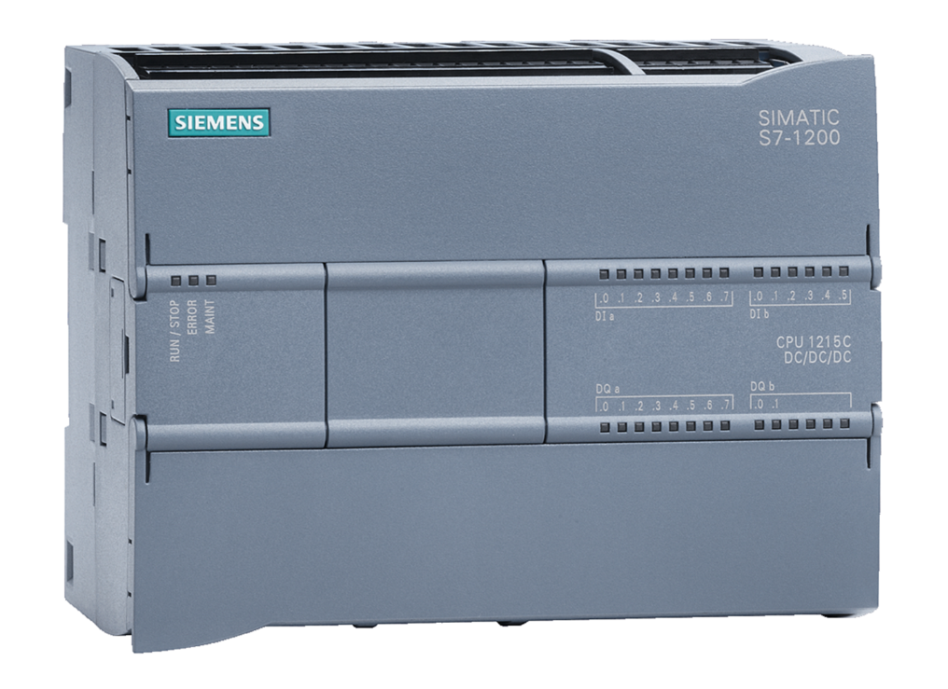
PLC used
Siemens SIMATIC S7-1200

Slide 11
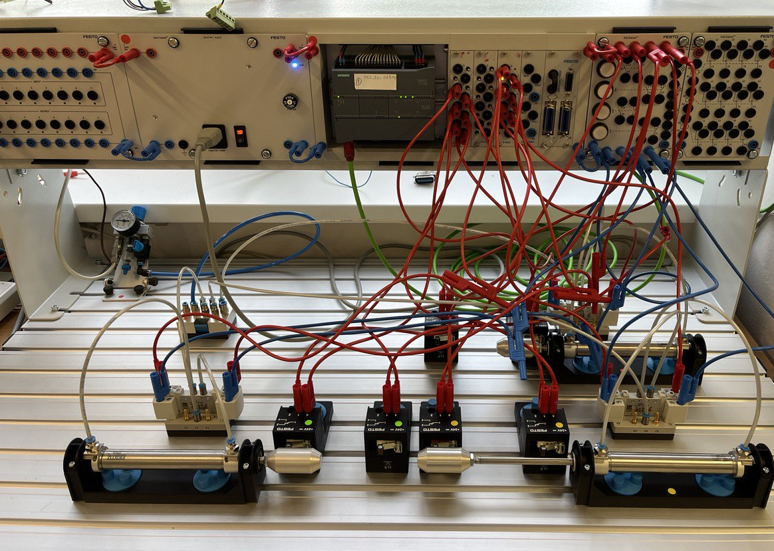
Physical connection

Slide 12
Thank you for your attention!

